Slide 1

Exploratory Data Analysis on AMEO

Slide 2
About me
B.Tech - Computer Science and Engineering
Data Science intern
Linkedin: https://www.linkedin.com/in/lokesh1111/
Github: https://github.com/kota-lokesh

Slide 3
Business Problem and use case domain understanding
The project aims to analyze the AMCAT data to understand the insights

Slide 4
Summary of the data
The dataset presents a rich source of information for exploring the factors contributing to the employment outcomes of engineering graduates, thereby enabling researchers and stakeholders to gain valuable insights into this important domain.

Slide 5
Data Cleaning
Finding outliers
Handing null values
datatype conversation

Slide 6
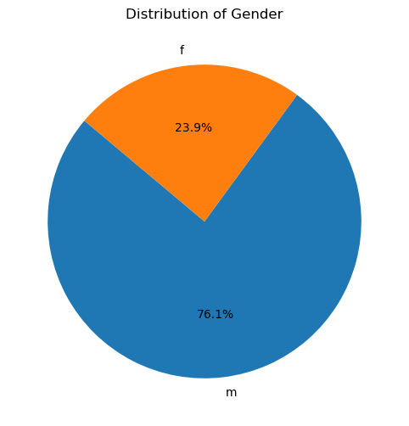
Univariate Analysis
The pie chart contains males accounting for 76.1% and females for 23.9% of the total distribution

Slide 7
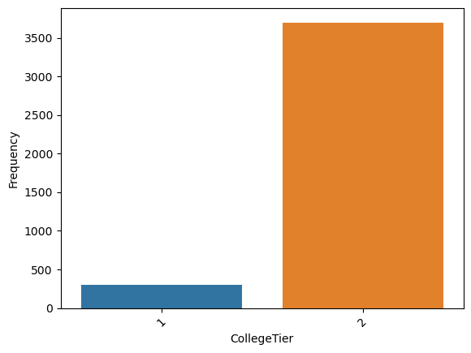
Most of the colleges have tier 2

Slide 8
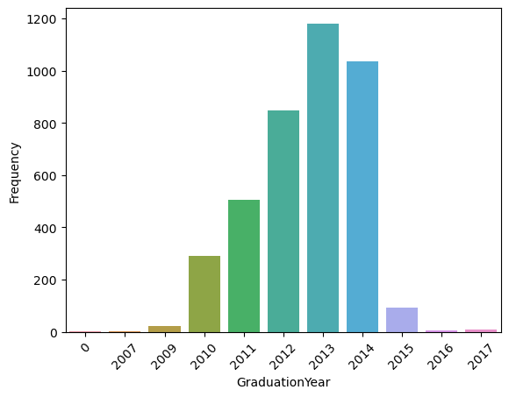
Most of them completed they graduation in 2013

Slide 9
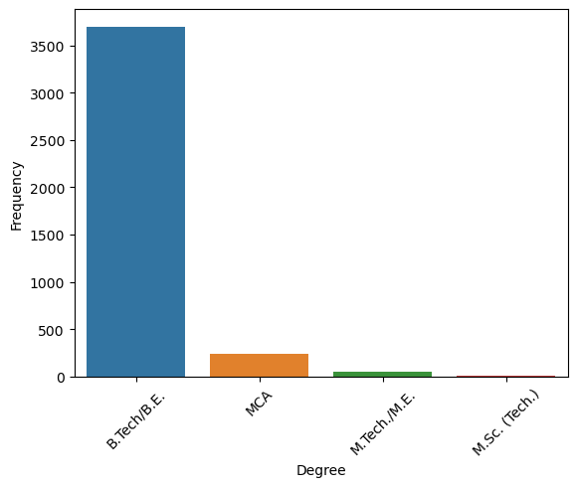
All of them are B.Tech graduates but some of them also did M.Tech and MCA

Slide 10
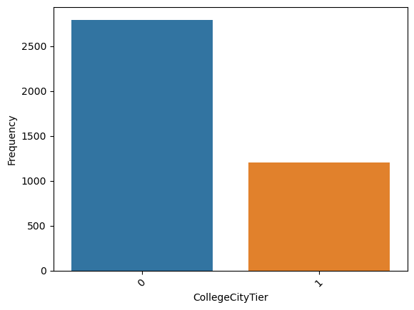
Most of the colleges are tier 0 cities

Slide 11
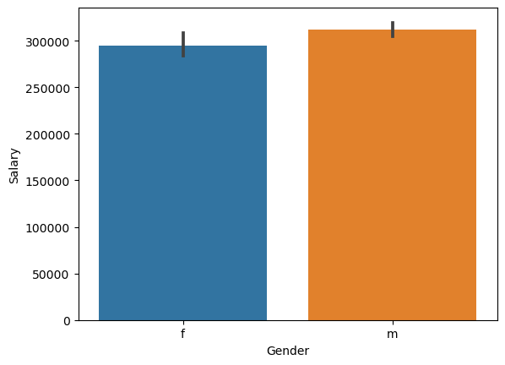
Bivariate Analysis
Average salary of male higher than compare to female

Slide 12
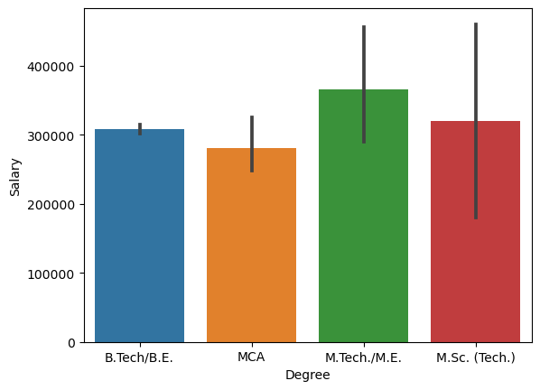
M.Tech graduates has the highest average salary compare to other graduates

Slide 13
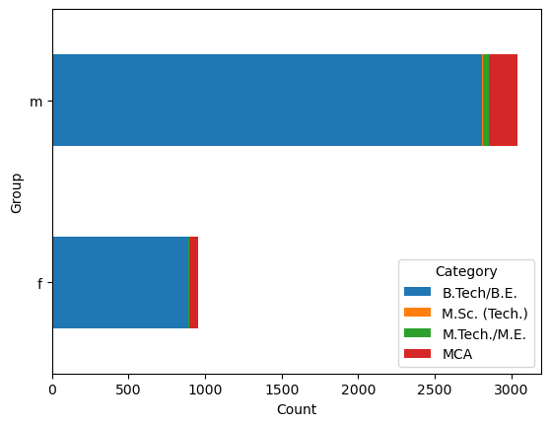
Most of the males and females have pursued B.Tech degrees

Slide 14
Key business question
Times of India article dated Jan 18, 2019 states that “After doing your Computer Science Engineering if you take up jobs as a Programming Analyst, Software Engineer, Hardware Engineer and Associate Engineer you can earn up to 2.5-3 lakhs as a fresh graduate.” Test this claim with the data given to you.
Is there a relationship between gender and specialization?
Is there a relationship between salary and gender?
Is there a relationship between salary and degree?
Is there a relationship between salary and job city?

Slide 15
Conclusion
When analyzing the amcat data the first point that we can understand is that most of them has taken amcat join as the software engineers
Most of the candidates who has written amcat graduated in 2013.
Most of the candidates are B.tech graduates
most of candidates who have higher average salary are male
Most of candidates who have higher average salary are M.Tech Graduates
Most of the candidates both the category male and female who have written the amcat are from B.Tech background

Slide 16

THANK YOU

